Slide 1
IMAGE PROCESSING FOR BREAST CANCER
DARIUS ALIZADEH, SAI BAVISETTY, EFSTATHIOS CHRONTSIOS, YUNDI KONG, BOWEI ZHAO

Slide 2
INTRODUCTION
Mammograms are huge 4000 x 4000 images
Cancer constitutes only 10-20 % of the image
It is hard to see it for a human
Given a huge mammogram, identify the patches that are cancerous

Slide 3
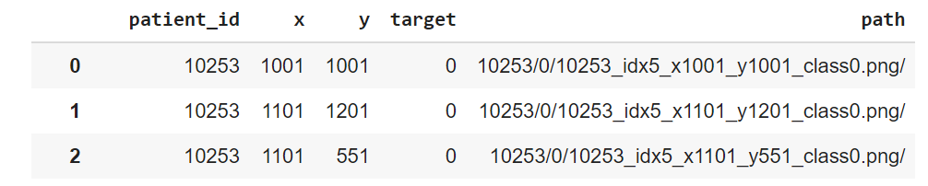
What does the data look like?
About 250 patients
Each patient has hundreds of patches
More healthy patches than cancerous patches in general

Slide 4
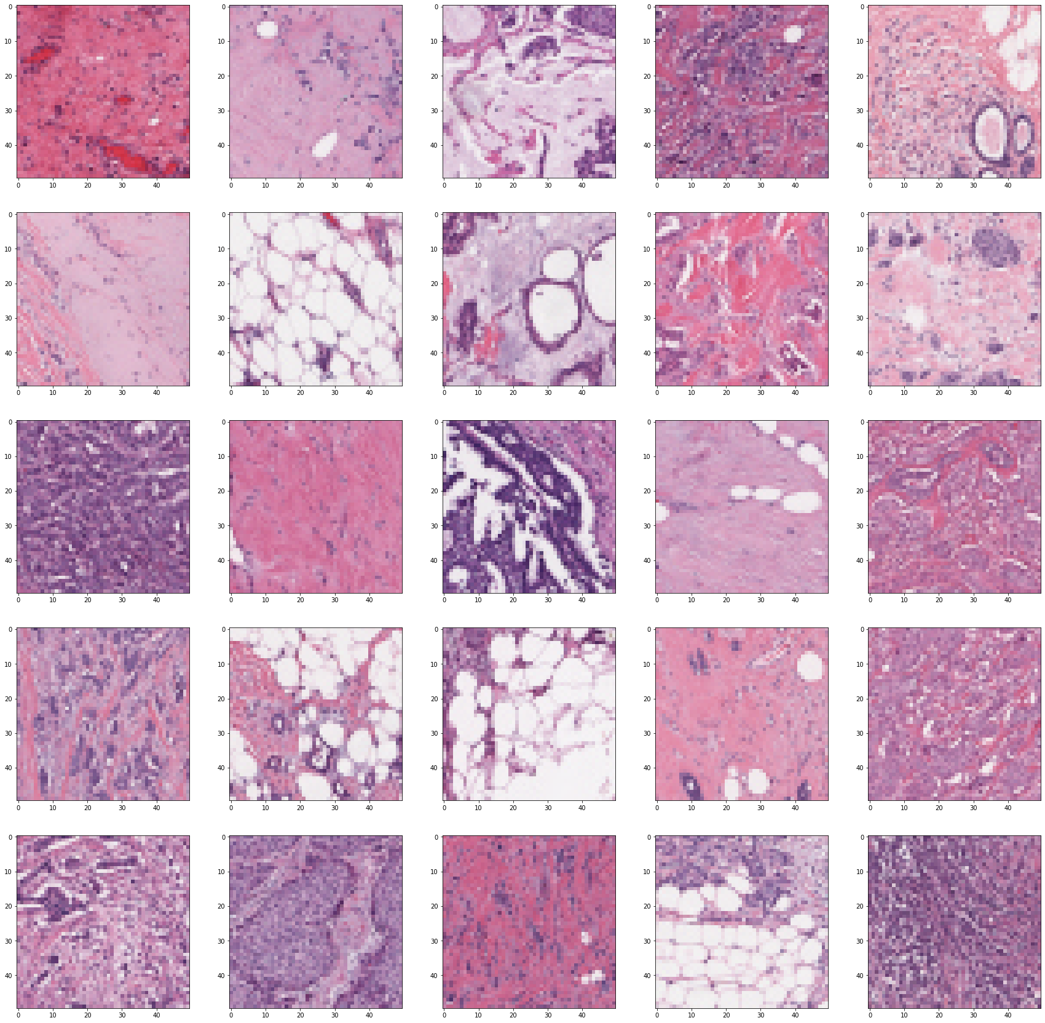
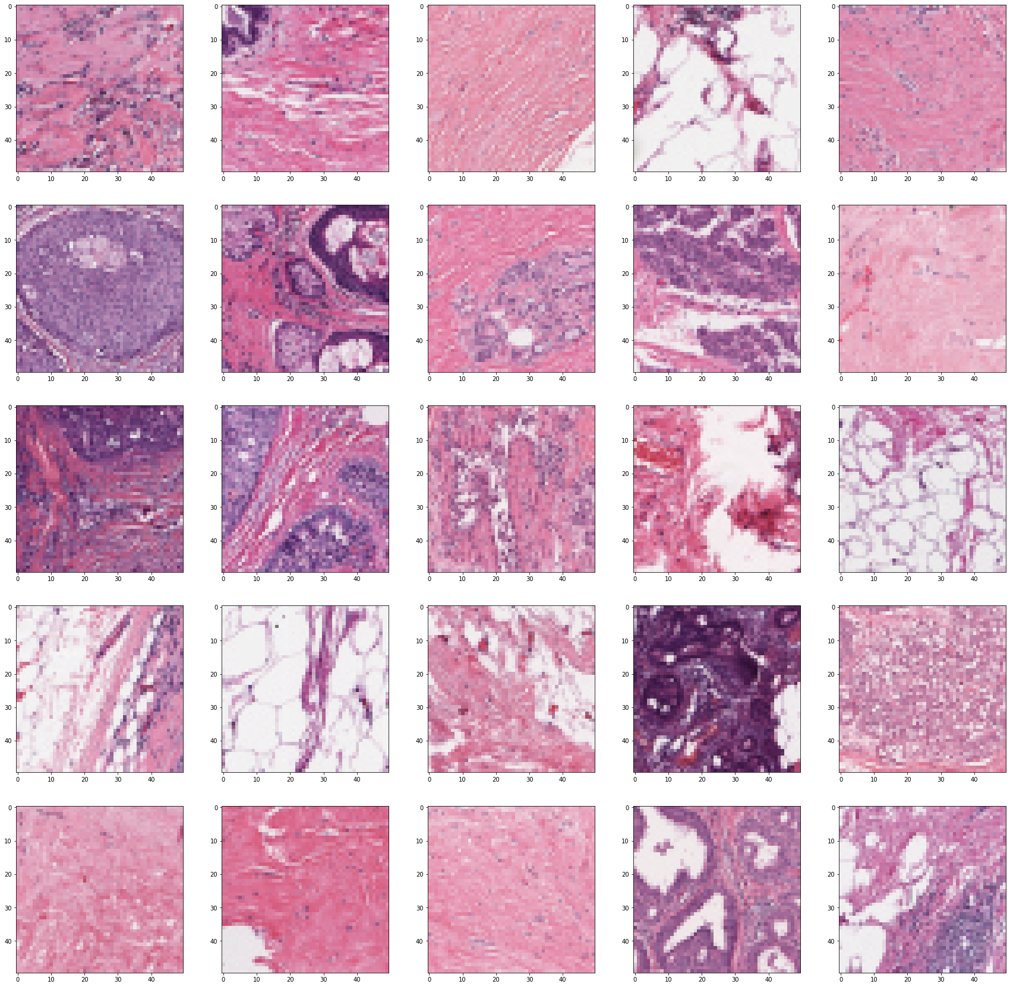
Positive vs Negative

Slide 5
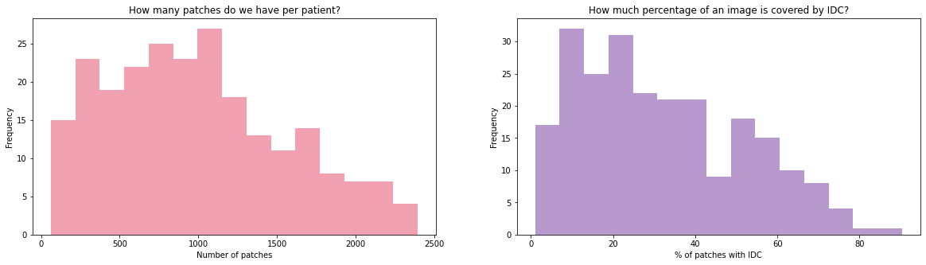
VISUALISATION OF DATA
Most patients have around 1000 patches.
The range of numbers of patches vary from patient to patient.

Slide 6
VISUALISATION OF DATA
Most patches only constitutes 10%~20% cancerous tissue.

Slide 7
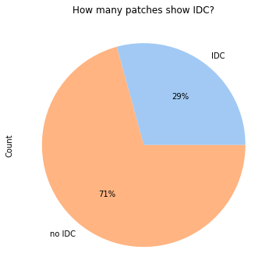
Proportions of IDC(cancer detected) and non-IDC(cancer not detected)
We mainly want to detect the cancerous part of tissue.

Slide 8
Now we have an idea of the data and ready to do something more!
Question: How to visualize the distribution of cancerous tissue in a mammogram?

Slide 9
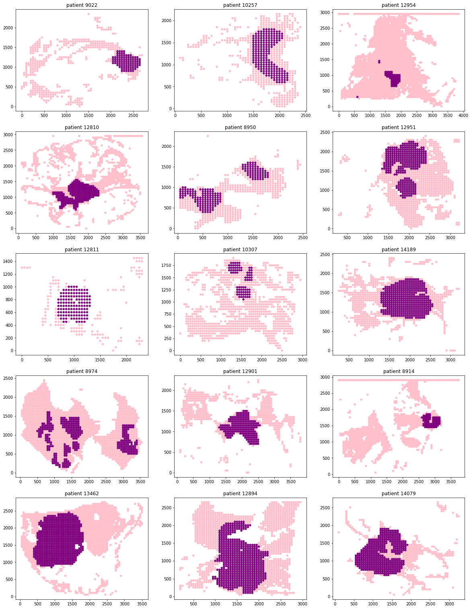
Binary Target Visualization
Example: Patient #12894
Using x and y coordinates to make the plot.
Darker part: breast cancer detected
Time cost: PRETTY FAST AND CONVENIENT

Slide 10
Binary Target Visualization

Slide 11
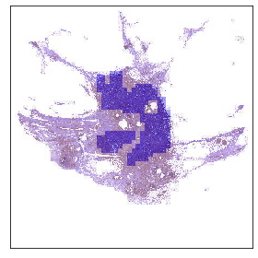
Remodeling the Original Breast Tissue Images
Example: Patient #8863
Using the image instead of x and y coordinates.
Darker part: breast cancer detected
Time cost: 9m 30s

Slide 12
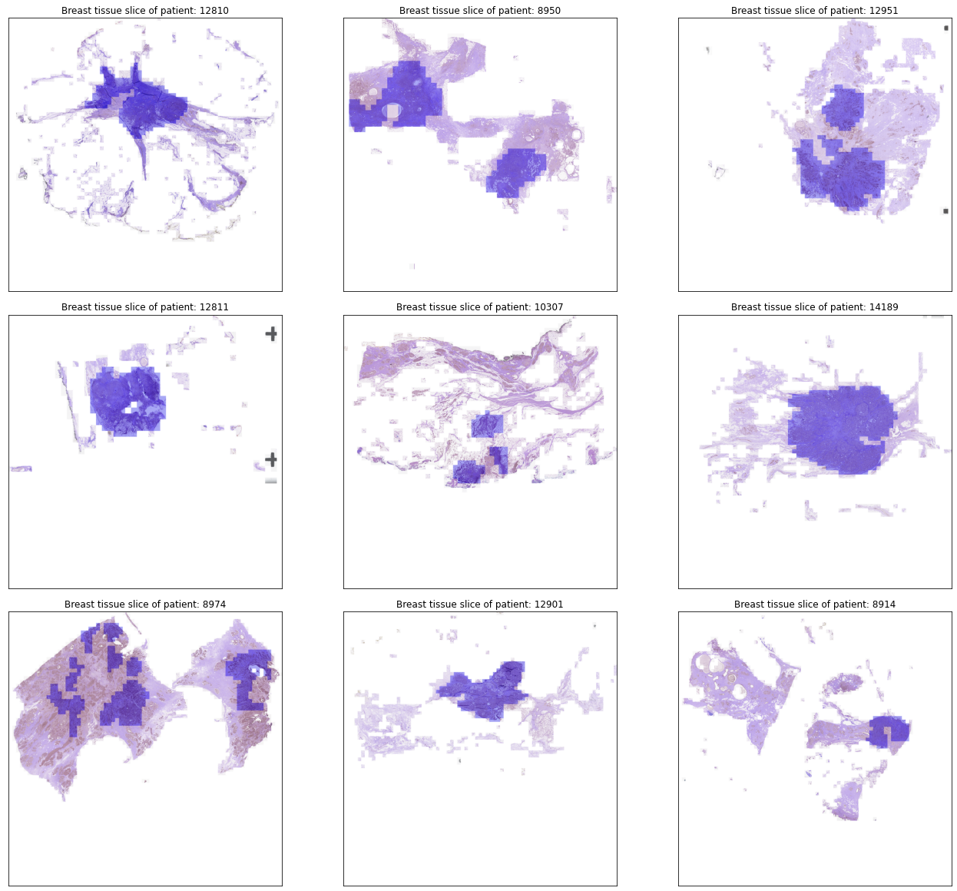
Remodeling the Original Breast Tissue Images
Though we can clearly visualize the distribution of the cancerous patches in this way, but it’s not efficient!!

Slide 13
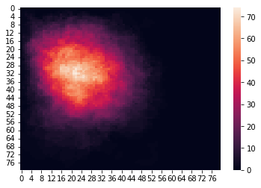
Where does cancer appear most often?

Slide 14
Main Issues
Bias in Data!
Huge dataset- Each patient’s file is 10 MB. Total 2GB. Cannot even run PCA on the dataset

Slide 15
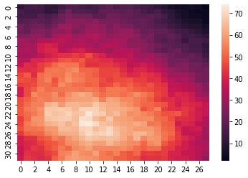
Refining our data
Use the heat map to recognize the important region!
Sample from the region where cancer is most likely!
Reduces size, makes PCA feasible.
Reduces Bias

Slide 16
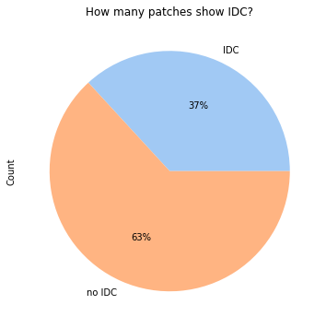
After resampling

Slide 17
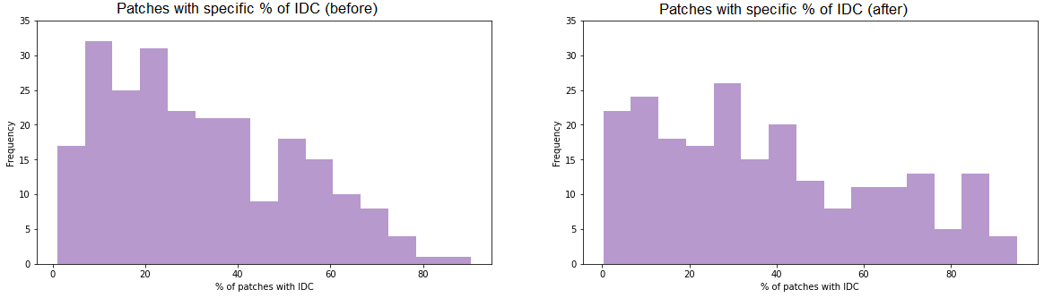
After resampling

Slide 18
Main issues
Images are still too big to be inputted into classifiers as they are.
Each image is 50 x 50 x 3 and there are 100,000 images

Slide 19
PCA
Principal component analysis can be used to reduce dimension of feature space
PCA reduced dimension from 7500 to 500
Now we can apply classifiers!
Trim the dataset by applying a filter for regions where cancerous tissues more likely will occur.
Dealing with errors that the PCA algorithm occasionally runs into

Slide 20
PCA transform results on the images
[0.45092881 0.03822891 0.03516545]
[45.09288135 48.91577282 52.43231755 55.45319051 56.78958564 58.0487503
59.05515025 59.77985437 60.49526818 61.09011225 61.62750207 62.08957844
62.52582253 62.9344693 63.30617584 63.66444104 64.00583154 64.33291588
64.65898936 64.96386283 65.24391476 65.50987098 65.76816476 66.01877581
66.26169042 66.49263428 66.71839271 66.93541782 67.14566107 67.3516977
67.55194305 67.75141338 67.94632613 68.13896493 68.31854123 68.49104384
68.66168783 68.82969735 68.99270419 69.152607 69.30974726 69.46187205
69.60847352 69.7535516 69.89512629 70.03431423 70.17016432 70.3033681
70.43502101 70.56147762 ……. 86.67396589]

Slide 21
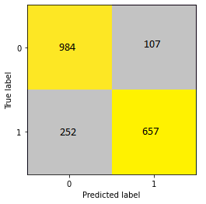
Logistic regression
Logistic regression classifies cancer accurately 83%.

Slide 22
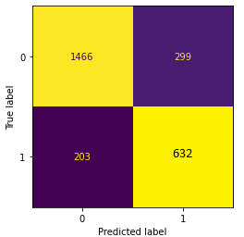
Ridge regression and SVM
Ridge regression and SVM have similar results around 83%.

Slide 23


Future work
Use ridge regression to control model complexity
Use CNNs

Slide 24

Thank You

